Slide 1
Anomaly Detection
Final Project

Slide 2
Team
Bill Wilson
Nish Garg
Aditi Sharma

Slide 3
Initial Thoughts
Create a solution which is not product or industry specific
Self Learning and division of work

Slide 4
Technologies Used
ML programming- Python, mpu, scikit-learn
JavaScript – D3, jQuery
UX design: HTML, CSS, Bootstrap
Flask
Heroku

Slide 5
Data Source
https://www.kaggle.com/mlg-ulb/creditcardfraud

Slide 6
Demo
Interactive App

Slide 7
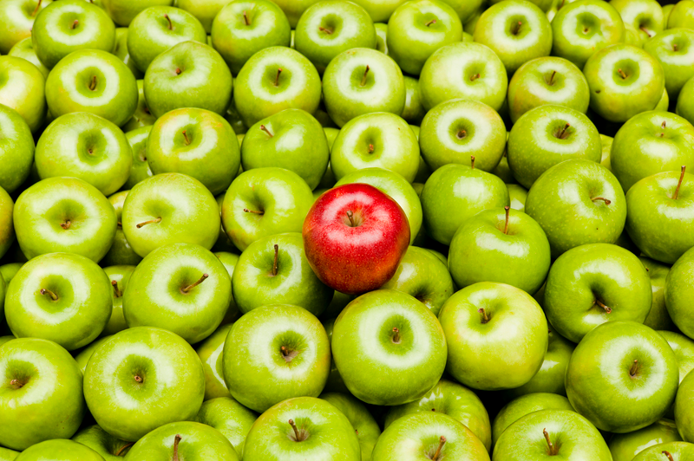
Unsupervised Learning

Slide 8
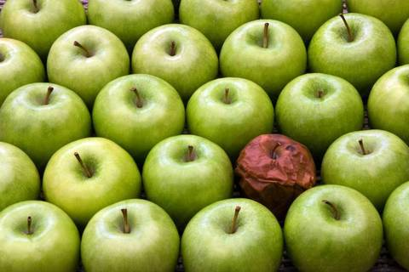

Slide 9
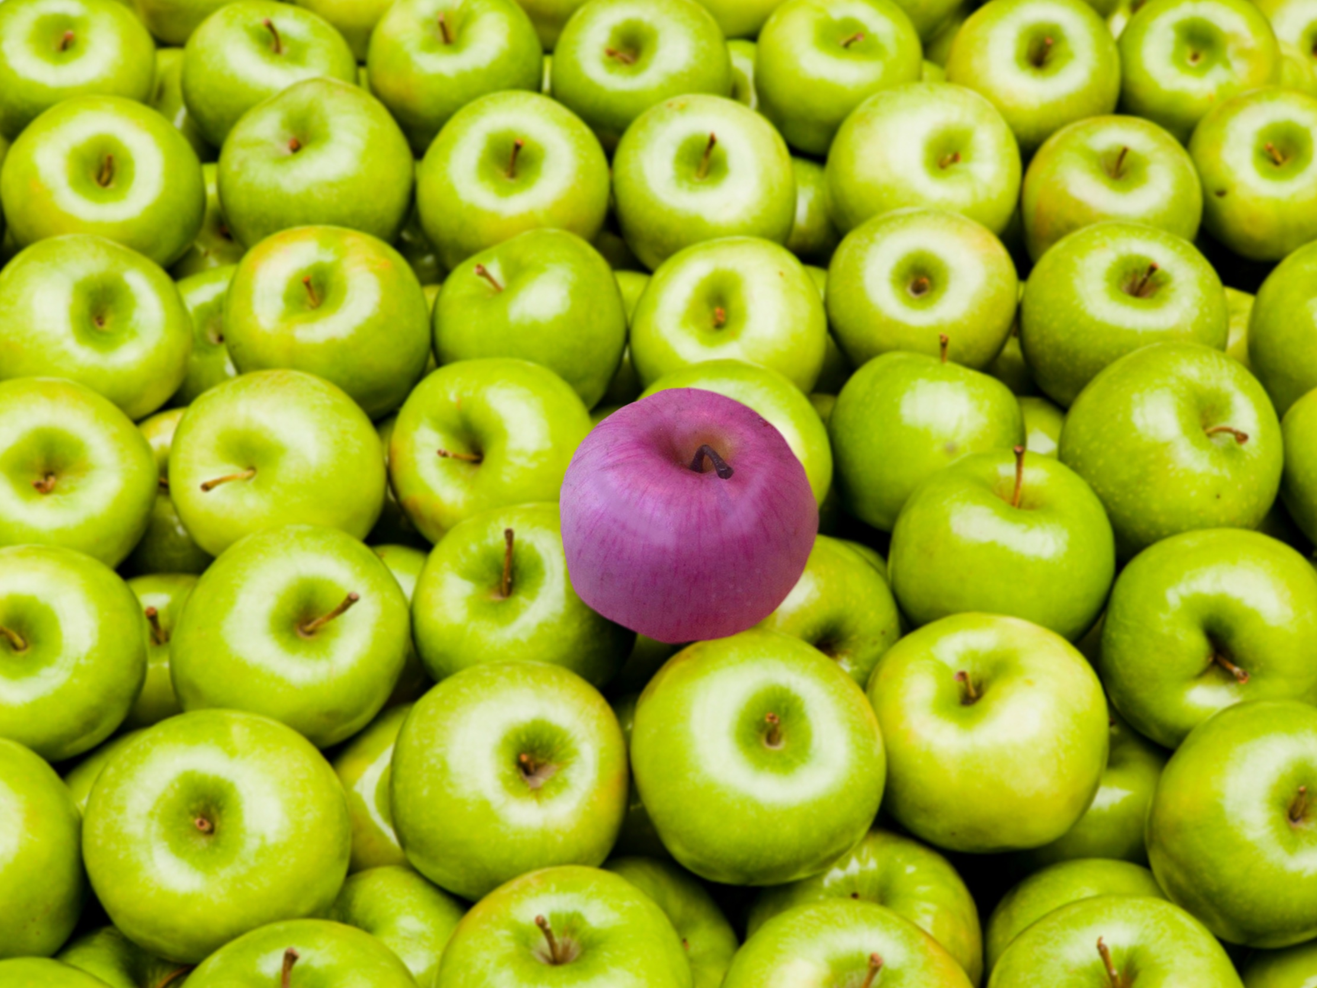

Slide 10
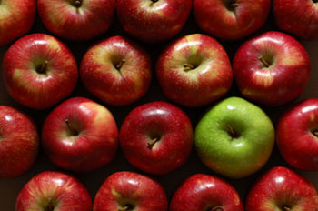

Slide 11


Slide 12


Slide 13


Slide 14
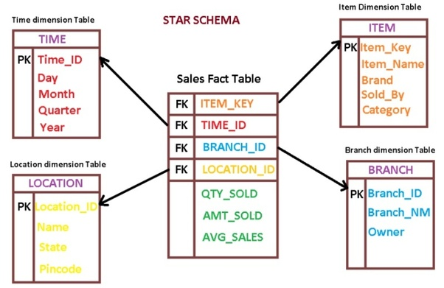
Creating testing data

Slide 15
Detection Outliers in Univariate space
Three Sigma Rule
Median absolute deviation Rule
Boxplot Rule

Slide 16
Detection Outliers in Multivariate space
LOF: Identifying Density-Based Local Outliers
Angle-Based Outlier Detection in High-dimensional Data

Slide 17
Supervised Learning
Anonymous data- PCA
<Paste data received from Bill>
New Models

Slide 18
Questions?

